Slide 1
Team 2(Webyte)
An engaging Educational Video Game
October 9th,2024

Slide 2
Prepared For: Katrina Patel
Prepared By: Navjot Kaur, Savio Gopuran Babu, Nouraldin Hassan, Lijoy Victor John Lekha, Khushpreet Kaur Algonquin College Professor: Asim Javaid Butt

Slide 3


Team 2 Webyte
Navjot kaur
Nouraldin Hassan
Team Leader
Assistant Team Leader
kaur1066@algonquinlive.com
hass0443@algonquinlive.com

Slide 4

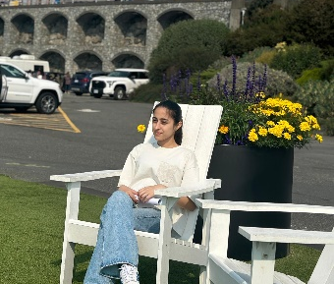

Software Developers
Lijoy Victor John Lekha
john1467@algonquinlive.com
Khushpreet Kaur
kaur1155@algonquinlive.com
Savio Gopuran Babu
gopu0001@algonquinlive.com

Slide 5
Introduction to the Product
Educational Video Games for Sustainable Consumerism is an interactive game designed for children aged 7-9 that teaches eco-friendly habits and sustainability. Players embark on an adventure to clean a polluted planet, learning about proper waste disposal, recycling, and resource management as they gather materials to rebuild their spaceship. With engaging gameplay and educational content, this game aims to instill a sense of environmental responsibility in young players, making learning about sustainability fun and accessible on mobile and web platforms.

Slide 6
Scope of the Project
Develop an educational video game aimed at children aged 7-9.
Focus on promoting eco-friendly habits and sustainable consumerism.
Players control children who crash-land on a polluted planet and must clean it up.
Goal is to collect waste, recycle, and restore the environment to rebuild the spaceship.
Teach proper waste disposal methods (recycling, composting, etc.).
Promote the use of eco-friendly, organic products like hemp.
Gameplay includes resource management, environmental conservation, and planet restoration.
Multiplayer functionality for real-time collaboration or competition in challenges.
Provide real-time feedback, hints, and educational content.
Accessible on mobile devices and web platforms for classroom use.
Target audience includes children aged 7-9, educators, and parents.

Slide 7
Functional Requirements
Multiplayer Collaboration: Connect and play with friends to complete tasks.​
Save Progress: Users can save and resume their game progress.​
Educational Content Delivery: Integrate eco-friendly lessons into gameplay.​
​Real-Time Feedback: Instant feedback based upon player's actions.​
​Hints and Guidance: Guide players with gameplay hints.​
​Browser-Based Gameplay: It can be played using major browsers such as Chrome without any installation.​
​Tutorial Mode: Guide a new user through basic game mechanics.​
​Achievement Tracking: Badges/rewards tracking for player achievements.

Slide 8
Non - Functional Requirements
Compatibility: Works on major web browsers such as Chrome, Firefox, and Edge; works on mobile.​
Performance: Ensure less than 2-second response time for all game actions.​
Compliance with Educational Standards: Meets guidelines for content suitable for children.​
Efficient Operation: Reduces loading time; gameplay is smoother.

Slide 9
Benefits To Client
Increased Awareness: The game raises awareness about environmental issues, helping to educate children and their families on sustainable practices.
Engagement: By using gamification, the product captures children's interest, making learning about eco-friendly habits enjoyable and memorable.
Community Impact: The game can contribute positively to local communities by promoting better waste management practices and encouraging children to participate in eco-friendly initiatives.
Educational Tool: It serves as an effective resource for schools and educators, aligning with educational standards and promoting discussions around sustainability.
Adaptable Content: The game can evolve to include new content and features based on changing environmental issues or advancements in sustainability, ensuring long-term relevance.

Slide 10
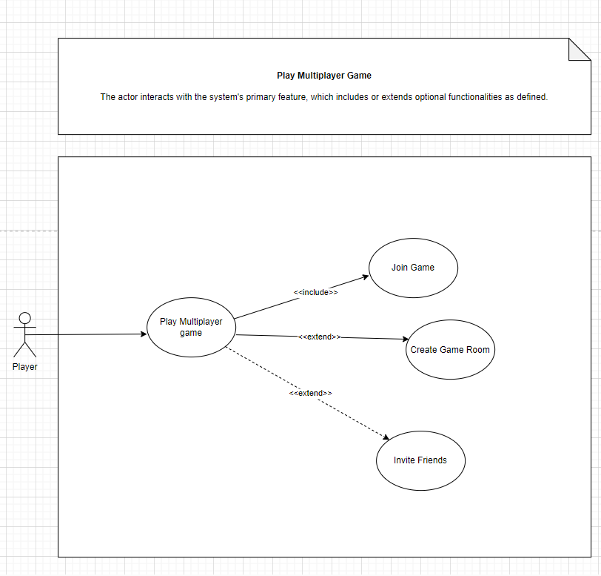
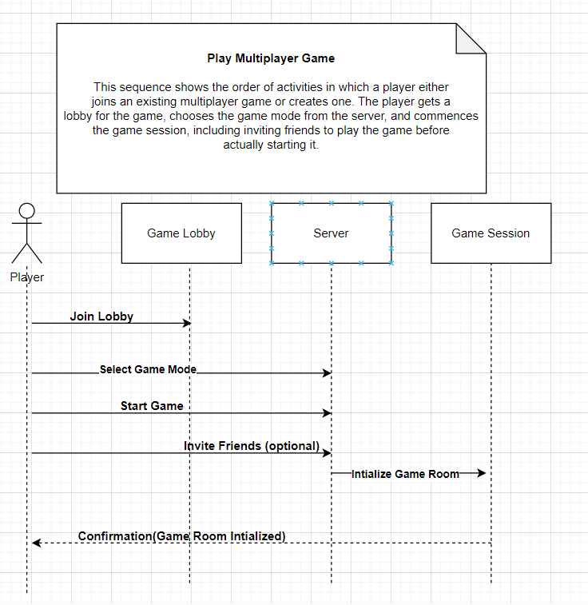
Multiplayer Collaboration
User Case
Sequence Diagram

Slide 11
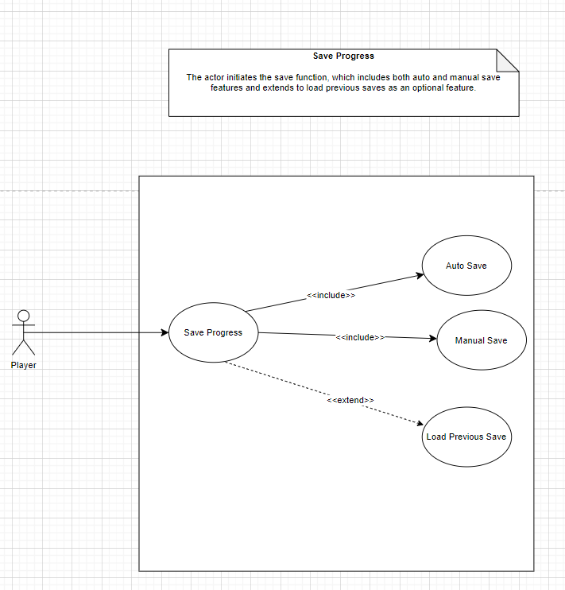
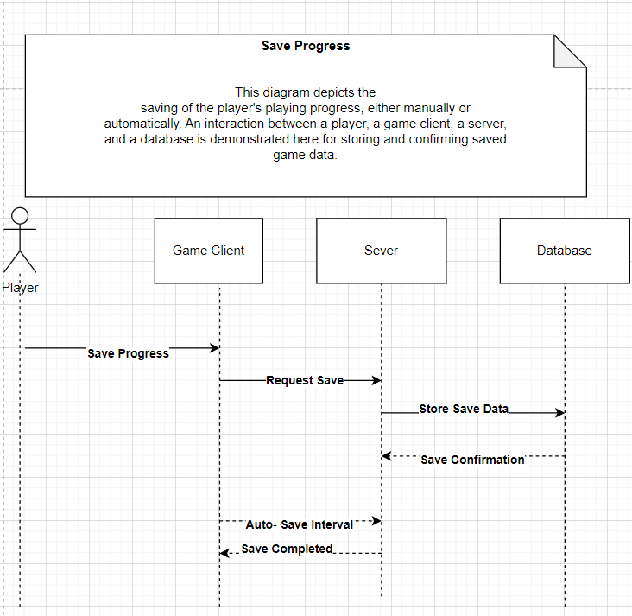
2. Save Progress
User Case
Sequence Diagram

Slide 12
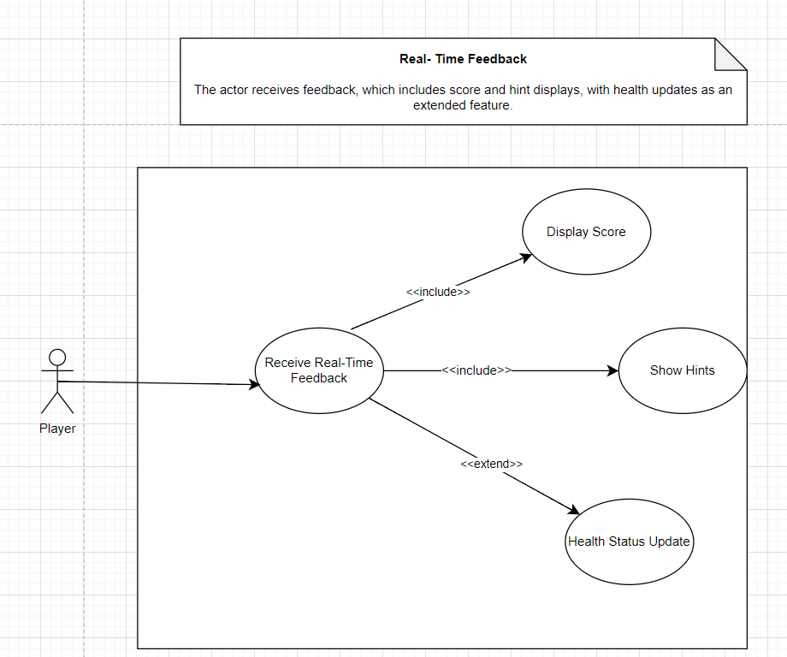
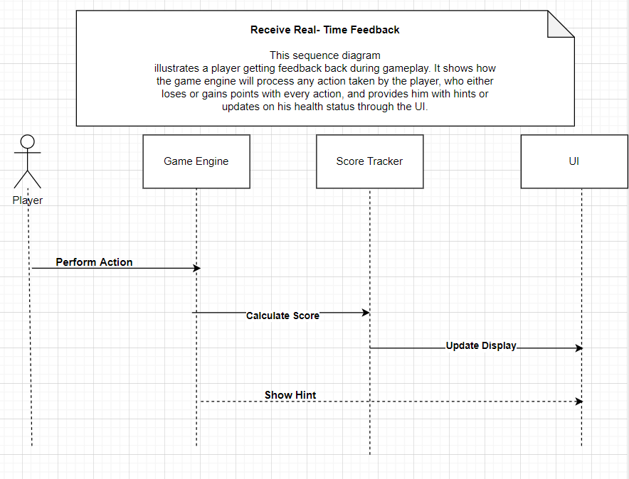
3. Real-Time Feedback
User Case
Sequence Diagram

Slide 13
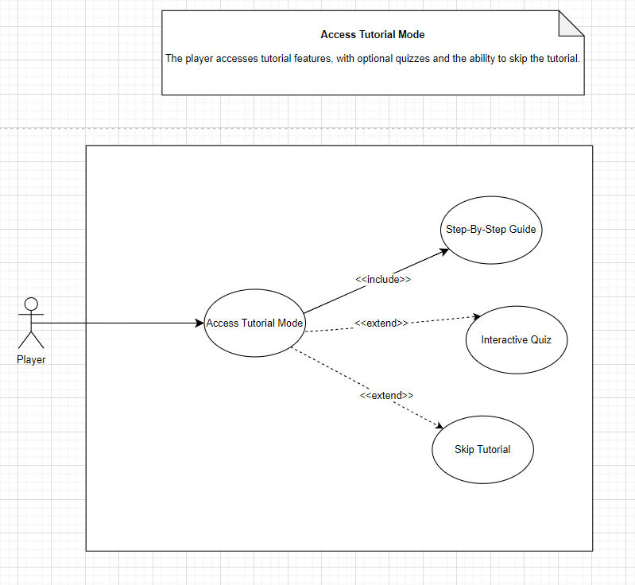
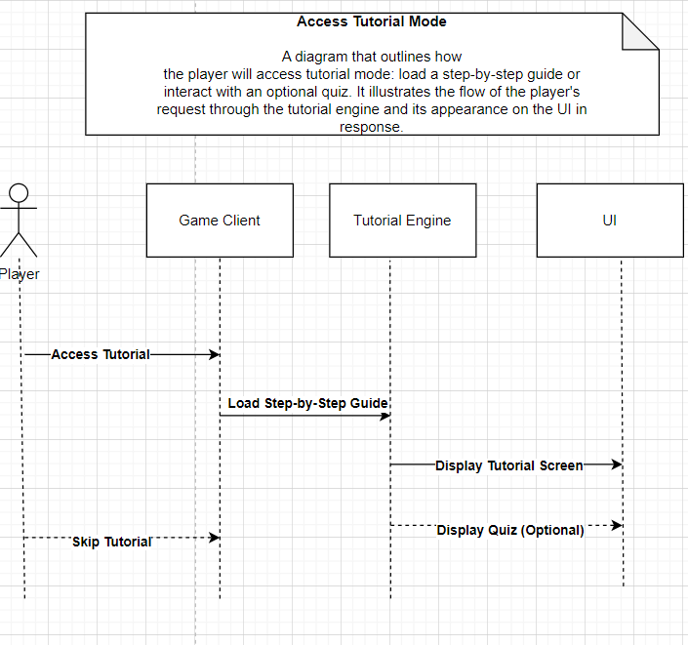
4. Access Tutorial Mode
User Case
Sequence Diagram

Slide 14
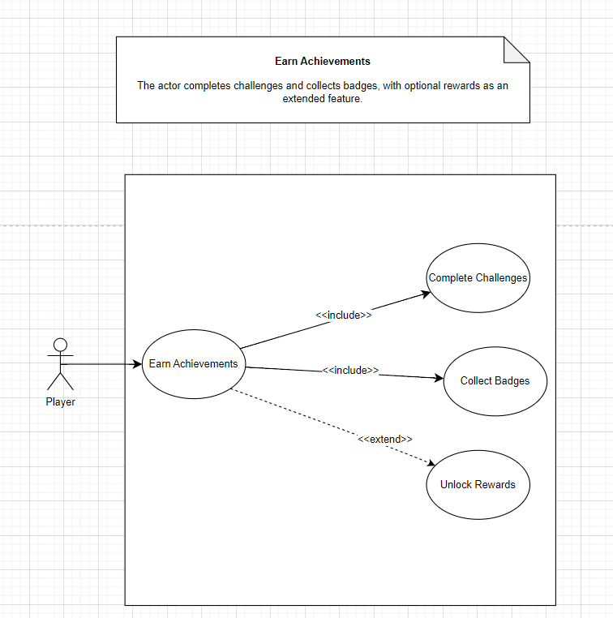
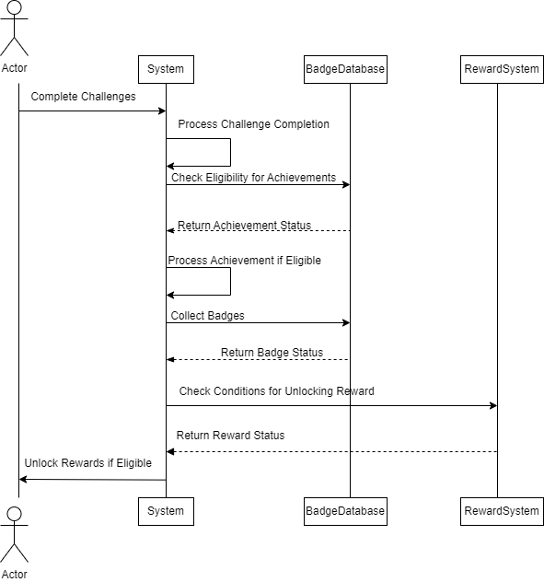
5. Earn Achievements
Sequence diagram
User Case

Slide 15
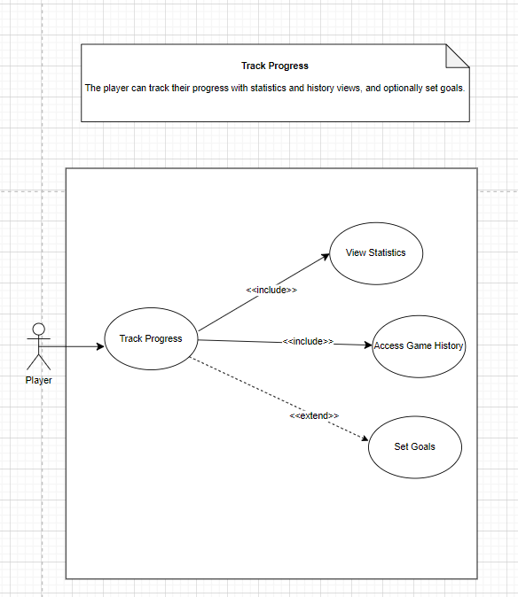
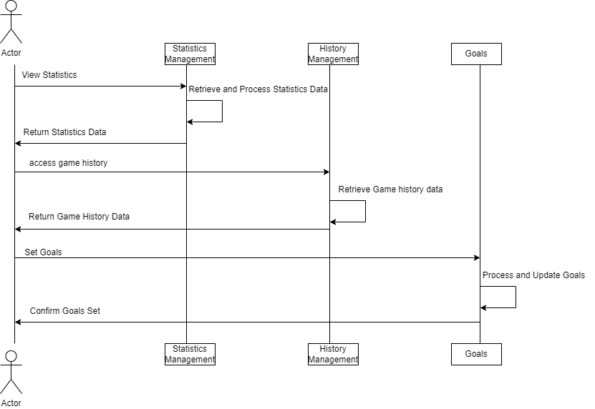
6. Track Progress
User Case
Sequence diagram

Slide 16
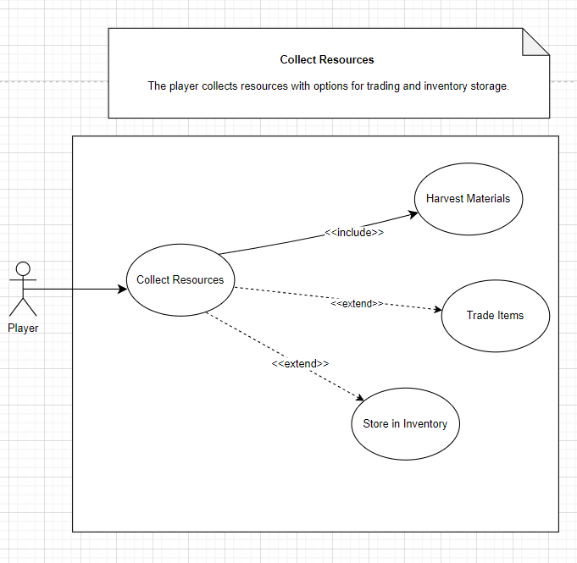
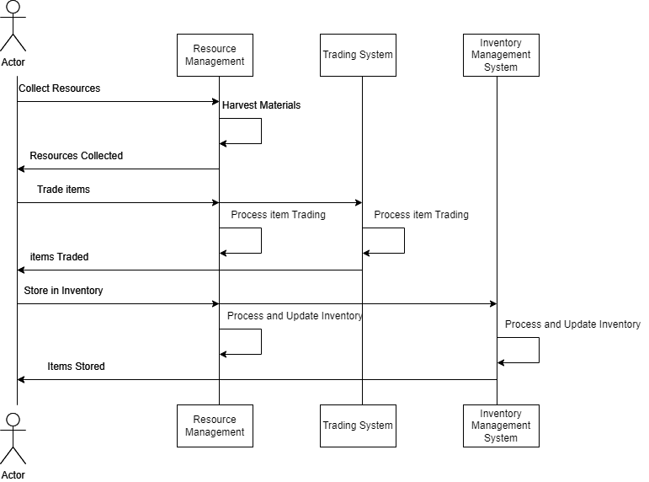
7. Collect Resources
User Case
Sequence Diagram

Slide 17
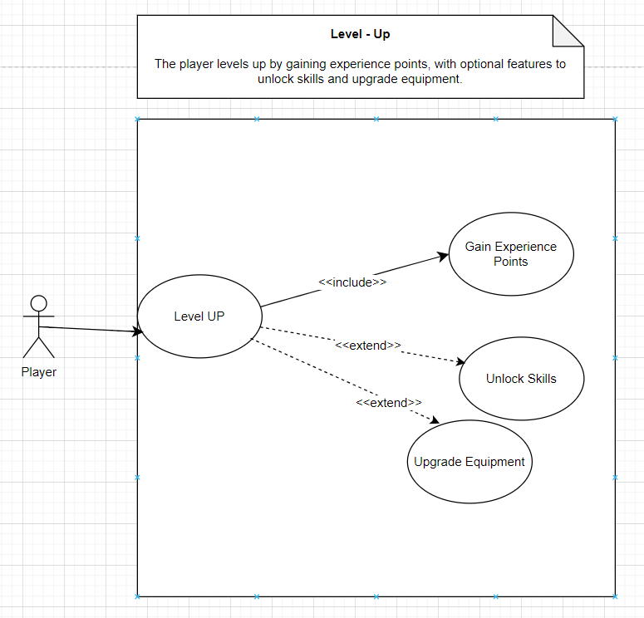
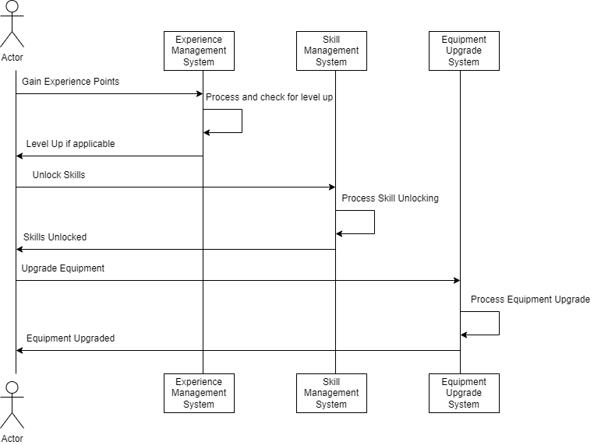
8. Level-Up
User Case
Sequence diagram​

Slide 18
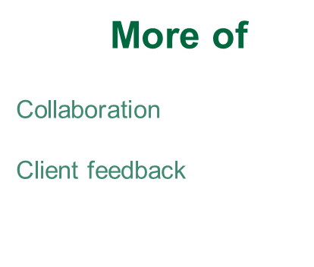
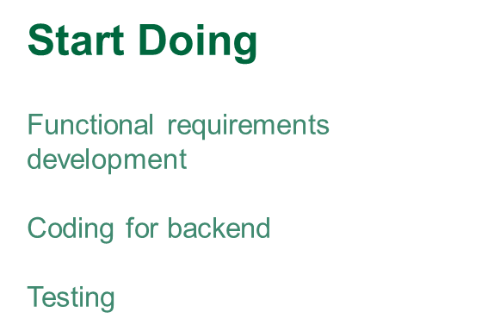

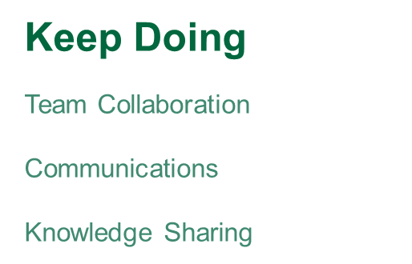
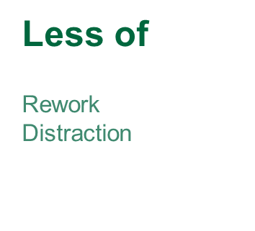
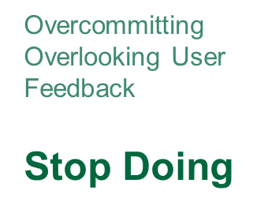
Retrospective

Slide 19
What we have learned: Team Collaboration and Dynamics Development Basic Requirements and knowledge about Project What will be Learning: Coding and Implementation Database Management
Conclusion

Slide 20
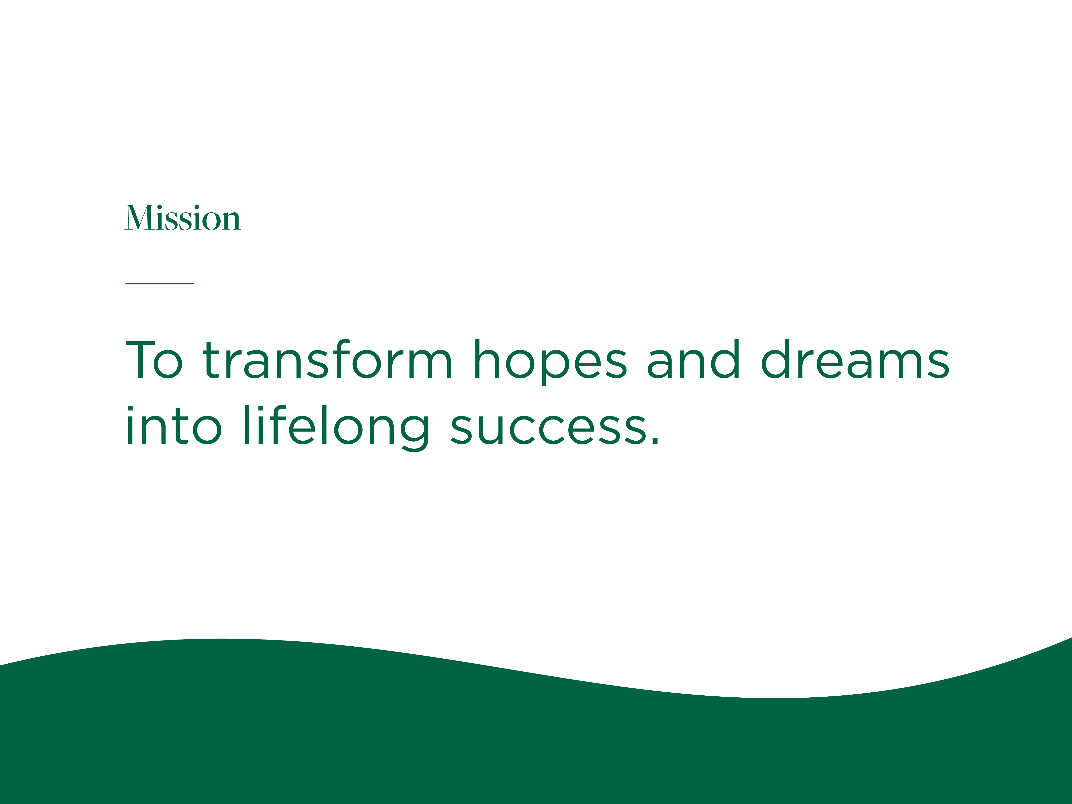

Slide 21
Thank you!
Q&A

